Slide 1
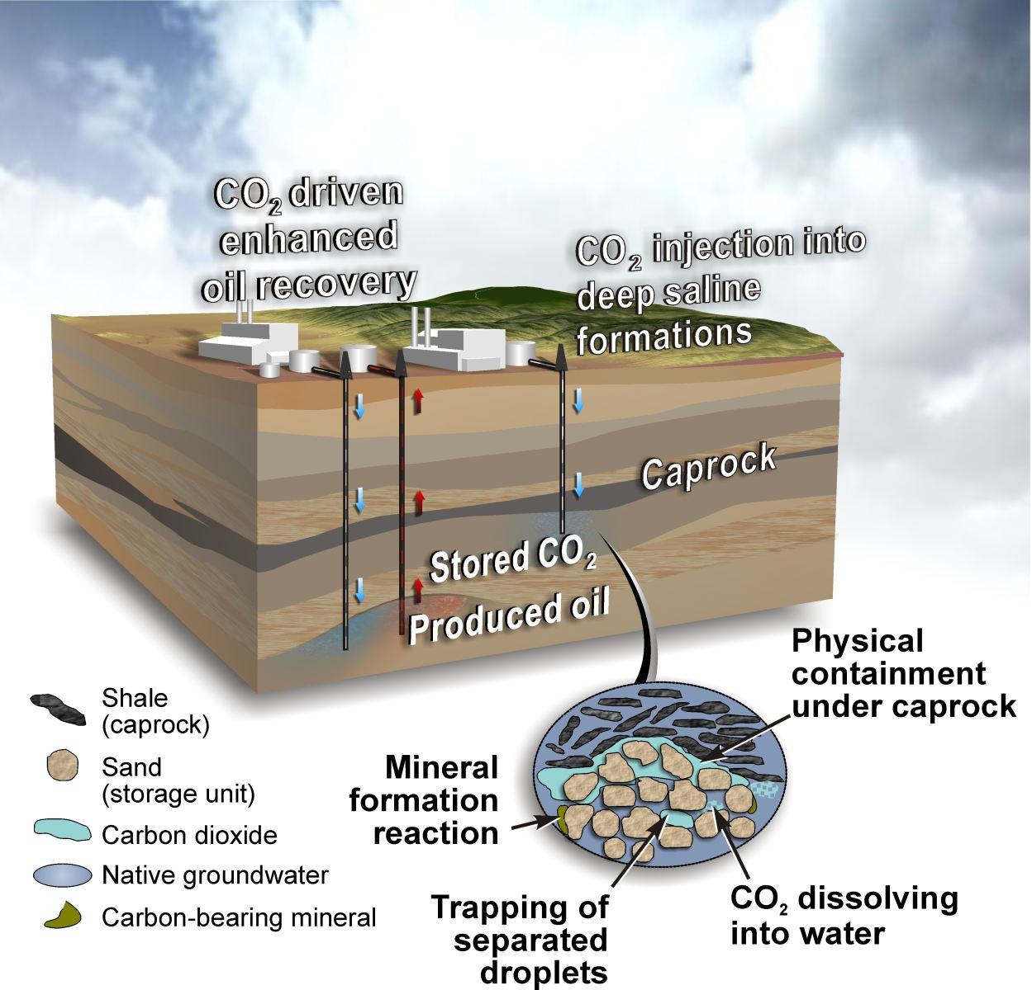
Carbon sequestration

Slide 2
Definition of carbon sequestration
Carbon Seqestration is the capture of excess carbon from power plants in the world, or other forms of fossil fuels.

Slide 3
The methods and processes
Carbon sequestration starts from the capture of carbon from power plants, and thought other processes of which produces carbon on a massive scale.
When carbon is caught it is compressed to be transported through pipe lines, or other forms of transportation.
Once transported carbon is injected under ground to store the carbon. Usually through stored in rock formations.
Areas that carbon are usually stored in are depleted oil areas, gas fields, deep coal seems, and saline formations.

Slide 4
Fossil fuels used in carbon sequestration
Types of fossil fuels used in carbon sequestration are coal and natural gas that are used from power plants and other processes. Are carbon based so all types of fossil fuels produce carbon dioxide.
The types of coal
Bitumous C132H97O9NS
Anthiacite C240H90O4NS
. Ethonal used as one of the fossil fuels. The chemical equation is C6H2O

Slide 5
Pro and cons of carbon sequestration
Pros
Reducing the co2 in the atmosphere.
climate change is stopped from accelerating.
Cons
Creating more problems for future generations
have to use more energy than what is used
Cost a lot of money to setup a market of carbon sequestration.

Slide 6
Locations of carbon sequestration

Slide 7
Citation page
"Carbon Dioxide Capture and Sequestration." Carbon Dioxide Capture and Sequestration. Web. 2 Nov. 2015.
Herzog, Howard, and Dan Golomb. "Carbon Capture and Storage from Fossil Fuel Use 1." Web. 30 Oct. 2015.
"Carbon Sequestration." Carbon Sequestration. Web. 23 Oct. 2015
Van Engelen, Angelique. "Carbon Capture And Storage: Solution or Boondoggle? – The Pros And Cons." Global Warming Is Real. 16 July 2009.
Carbon Dioxide Capture and Sequestration." Carbon Dioxide Capture and Sequestration. EPA United States Protection Agency.
Sundem, Garth. "How Does Carbon Sequestration Work?" HowStuffWorks. HowStuffWorks.com, 29 Aug. 2012.
Laursen, Lucas. "Inside the World’s Largest Carbon-Capture Test Facility." Inside the World’s Largest Carbon-Capture Test Facility. IEEE Spectrum, 25 Sept. 2013.
Overview of Carbon Storage Research." Overview of Carbon Storage Research. U.S Department of Energy. Web

